Slide 1
Luruuli-Lunyara Dictionary Project
Zarina Molochieva
U Kiel

Slide 2
Project: A comprehensive bilingual talking Luruuli/Lunyara-English dictionary with descriptive basic grammar for language revitalisation and enhancement of mother-tongue based education
Funding: VolkswagenStiftung, funding initiative: Knowledge for tomorrow – Cooperative Research Projects in Sub-Saharan Africa (Postdoctoral Fellowships in the Humanities in Africa)
Timeframe: 2017–2020
Host Institution: University of Hannover, Germany
Location: Makerere University, Uganda and University of Kiel, Germany
1/8

Slide 3
Project: A comprehensive bilingual talking Luruuli/Lunyara-English dictionary with descriptive basic grammar for language revitalisation and enhancement of mother-tongue based education
Funding: VolkswagenStiftung, funding initiative: Knowledge for tomorrow – Cooperative Research Projects in Sub-Saharan Africa (Postdoctoral Fellowships in the Humanities in Africa)
Timeframe: 2017–2020
Host Institution: University of Hannover, Germany
Location: Makerere University, Uganda and University of Kiel, Germany
1/8

Slide 4
Lurruli/Lunyara
the native language of the Baruuli/Banyara
spoken in the central region of Uganda
the Baruuli/Banyara as an ethnic group are estimated to be 160,000
2/8

Slide 5
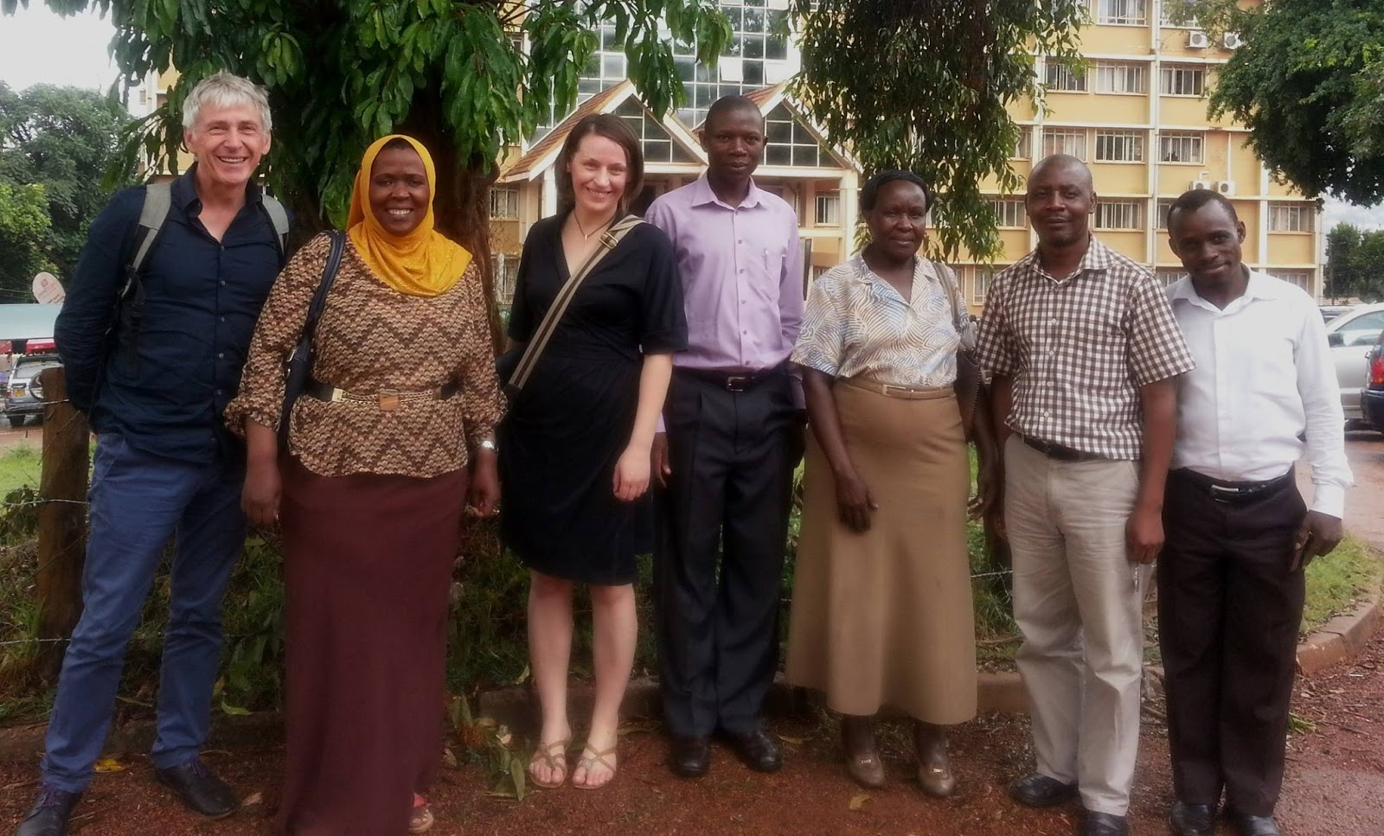
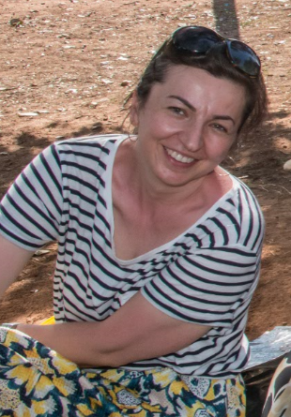
Team
Saudah Namyalo (PI)
Alena Witzlack-Makarevich (German partner)
Ruth Mukama (mentor)
Zarina Molochieva (German post-doc)
Matthias Brenzinger (mentor)
Amos Atuhairwe (PhD student)
Anatole Kiriggwajjo (PhD student)
3/8

Slide 6
Goals of the project
a lexical electronic database of approximately 10,000 entries (in Toolbox format)
500 printed copies of the Luruuli/Lunyara–English dictionary of approximately 10,000 entries
an online talking dictionary of approximately 10,000 entries published as a contribution to the electronic open-access journal Dictionaria
a mobile app of an adapted version of the dictionary
a grammar sketch of Luruuli/Lunyara
4/8

Slide 7
Goals of the project
a lexical electronic database of approximately 10,000 entries (in Toolbox format)
500 printed copies of the Luruuli/Lunyara–English dictionary of approximately 10,000 entries
an online talking dictionary of approximately 10,000 entries published as a contribution to the electronic open-access journal Dictionaria
a mobile app of an adapted version of the dictionary
a grammar sketch of Luruuli/Lunyara
4/8

Slide 8
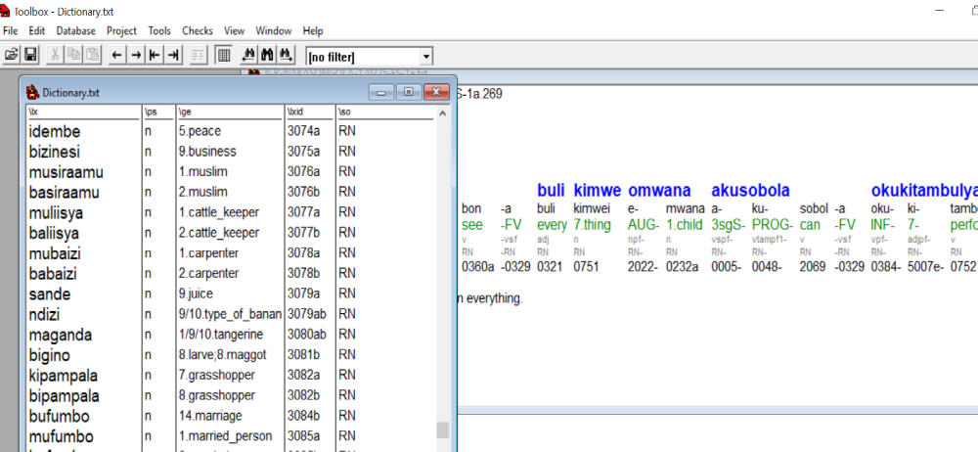
Toolbox Dictionary
5/8

Slide 9
Toolbox Dictionary
5/8

Slide 10
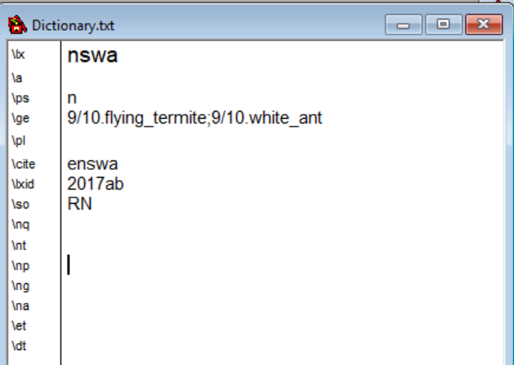
Toolbox Dictionary
\lx lexeme
\a alternative forms
\ps part of speech
\ge English translation
\pl plural form (for nouns)
\cite citation form
\lxid unique ID of the lexical item
\so language (for code switching)
6/8

Slide 11
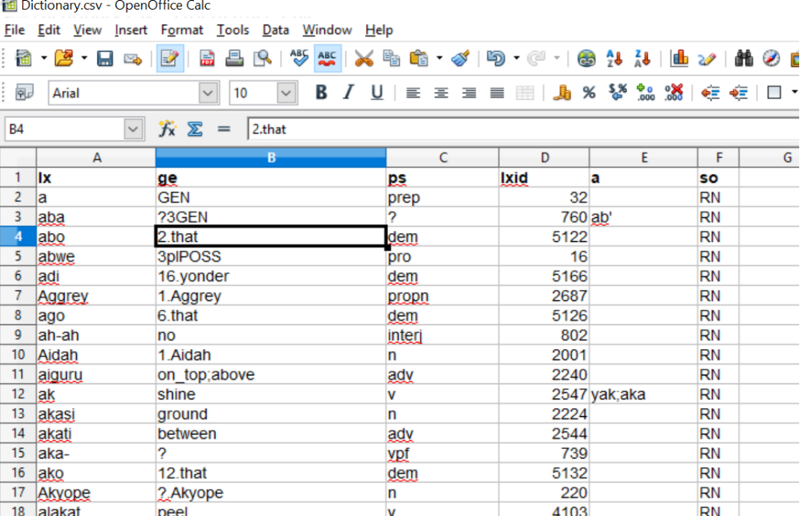
Toolbox Dictionary
7/8

Slide 12
Challenges
Turning Toolbox format into online publication
Morphology in the dictionary
Dealing with examples in the dictionary
8/8

Slide 13
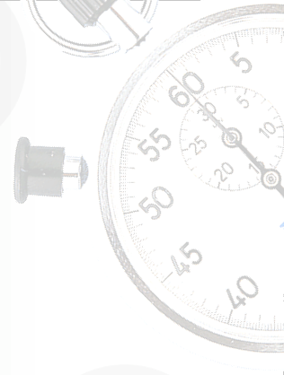
Time’s Up!
  Name: Zarina Molochieva
  Institution: University of Kiel, Germany

